Slide 1

AC Circuits
Sinusoidal Alternating Waveforms
By Dr. Ahmed S. Abdullah
د. احمد سليمان عبدالله

Slide 2

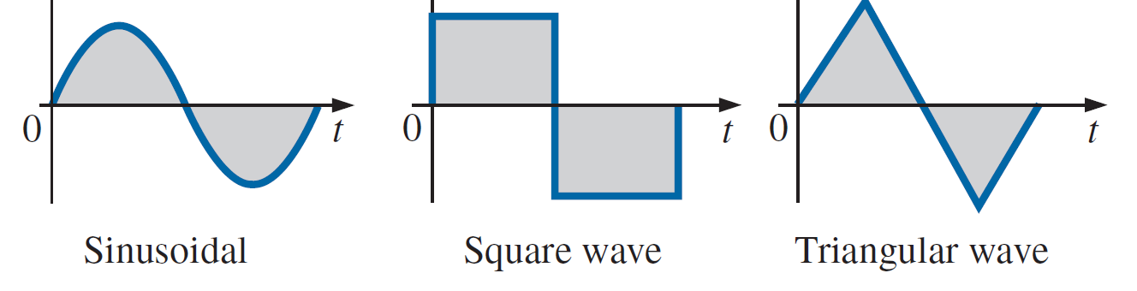
Sinusoidal Alternating Waveforms

Slide 3
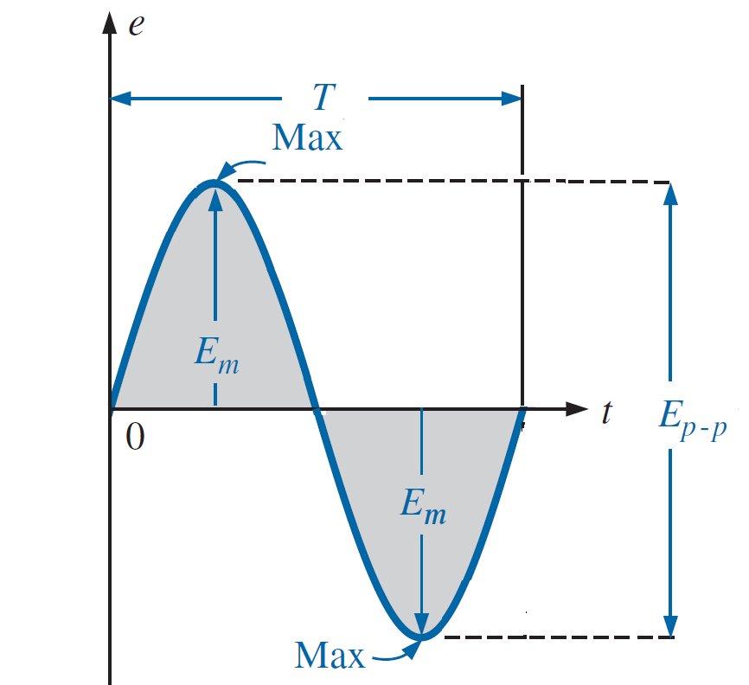
Sinusoidal voltage Waveform
Peak amplitude: The maximum value of a waveform as measured from its average, or mean, value, denoted by uppercase letters [such as E_{m} ]
Peak-to-peak value: Denoted by E_{p-p} or V_{p-p} the full voltage between positive and negative peaks of the waveform, that is, the sum of the magnitude of the positive and negative peaks.
Period (T ): The time of a periodic waveform.
Cycle: The portion of a waveform contained in one period of time.

Slide 4
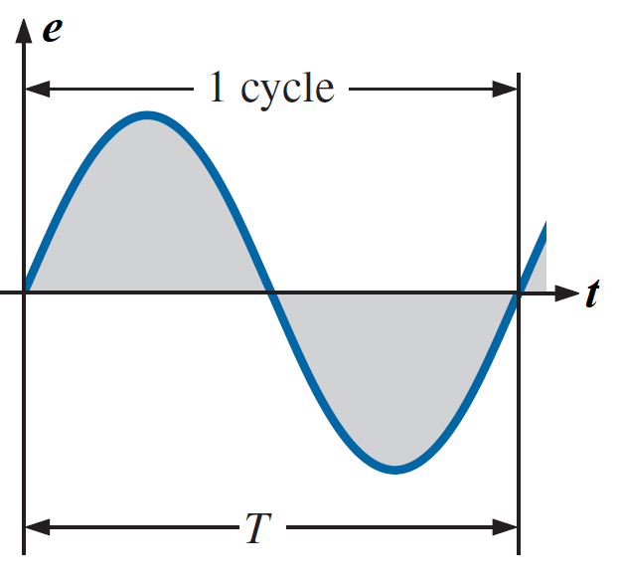
Sinusoidal voltage Waveform

Slide 5
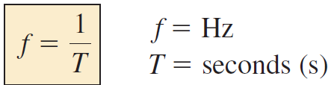

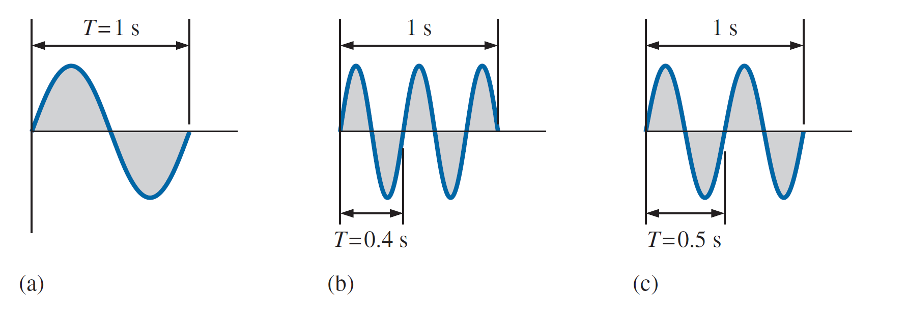



Sinusoidal voltage Waveform
Frequency ( f ): The number of cycles that occur in 1 s.
The unit of measure for frequency is the hertz (Hz), where
$$1 cycle$$
$$2.5 cycle$$
$$2 cycle$$

Slide 6
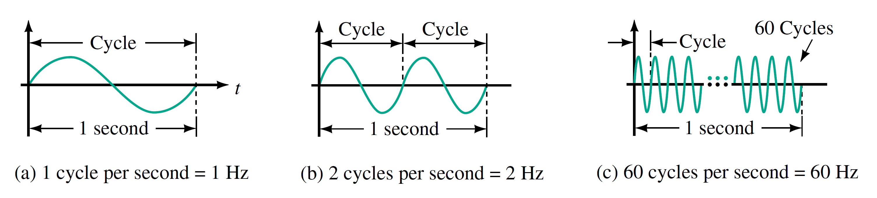
Sinusoidal voltage Waveform
Frequency ( f ): The number of cycles that occur in 1 s.
The unit of measure for frequency is the hertz (Hz), where

Slide 7
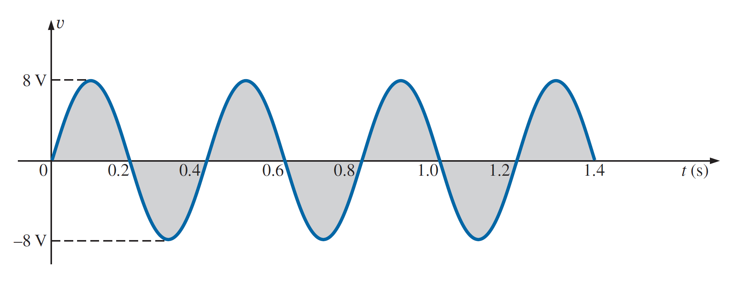
Sinusoidal voltage Waveform
EXAMPLE 1: For the sinusoidal waveform in Figure shown.
a. What is the peak value?
b. What is the instantaneous value at 0.3 s and 0.6 s?
c. What is the peak-to-peak value of the waveform?
d. What is the period of the waveform?
e. How many cycles are shown?
f. What is the frequency of the waveform?
Solutions:
a. 8 V.
b. At 0.3 s, 8 V; at 0.6 s, 0 V.
c. 16 V.
d. 0.4 s.
e. 3.5 cycles.
f. 2.5 cps, or 2.5 Hz.

Slide 8
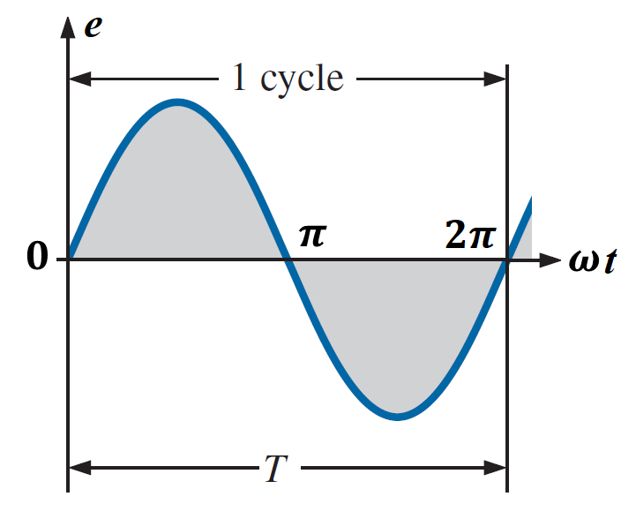
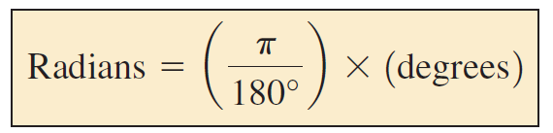
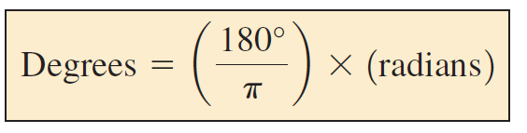
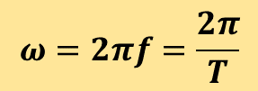



Sinusoidal voltage Waveform
The unit of measurement for the horizontal axis can be time, degrees, or radians.
$$θ=ωt$$
$$ω=2πf=\frac{2π}{T}$$
The angular frequency in radians/s
$${360}^{o}=2π radians$$
$$1 rad.=\frac{{360}^{o}}{2π}=\frac{{180}^{o}}{π}={57.3}^{o}$$
The conversions equations between the two are the following:

Slide 9
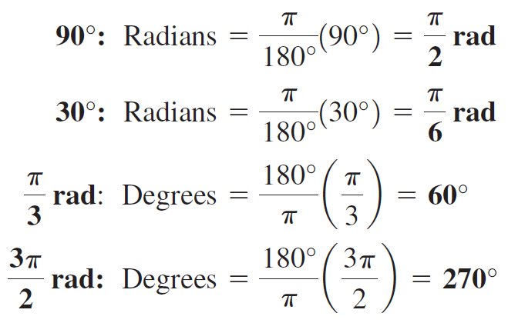
Sinusoidal voltage Waveform
Applying these equations, we find

Slide 10
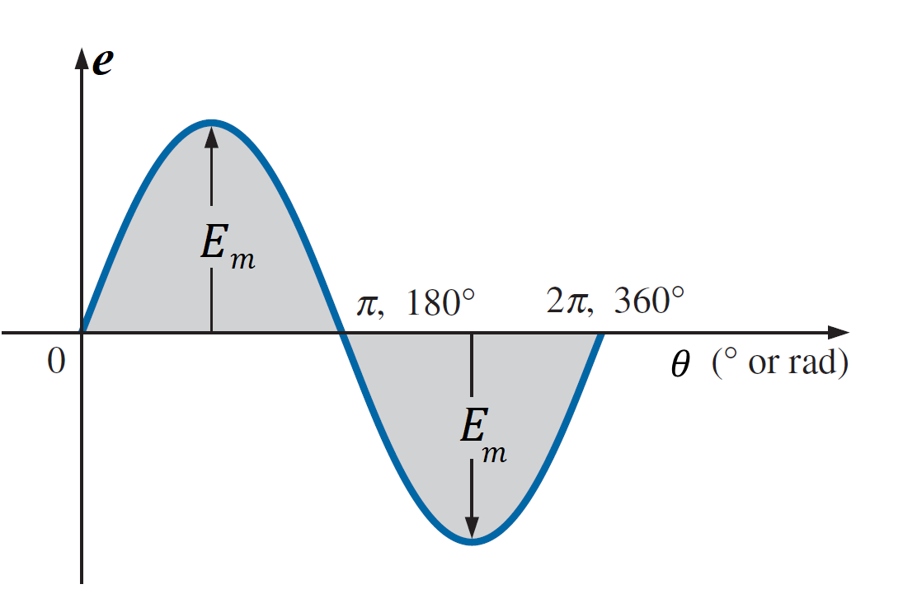

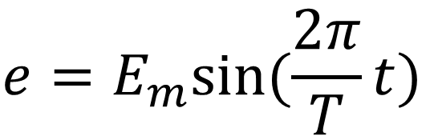


GENERAL FORMAT FOR THE SINUSOIDAL VOLTAGE
$${e=E}_{m}sin⁡(θ)$$
$${e=E}_{m}sin⁡(ωt)$$
$${e=E}_{m}sin⁡(2πft)$$
$${e=E}_{m}sin⁡(\frac{2π}{T}t)$$

Slide 11
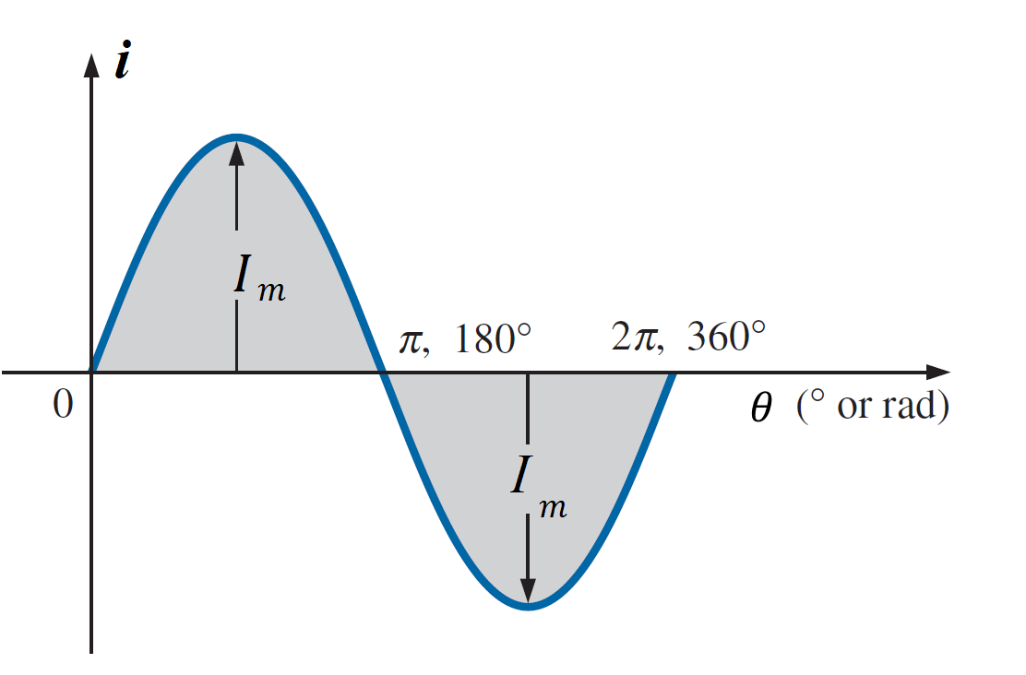

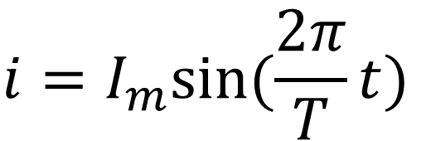


GENERAL FORMAT FOR THE SINUSOIDAL CURRENT
$${i=I}_{m}sin⁡(θ)$$
$${i=I}_{m}sin⁡(ωt)$$
$${i=I}_{m}sin⁡(2πft)$$
$${i=I}_{m}sin⁡(\frac{2π}{T}t)$$

Slide 12
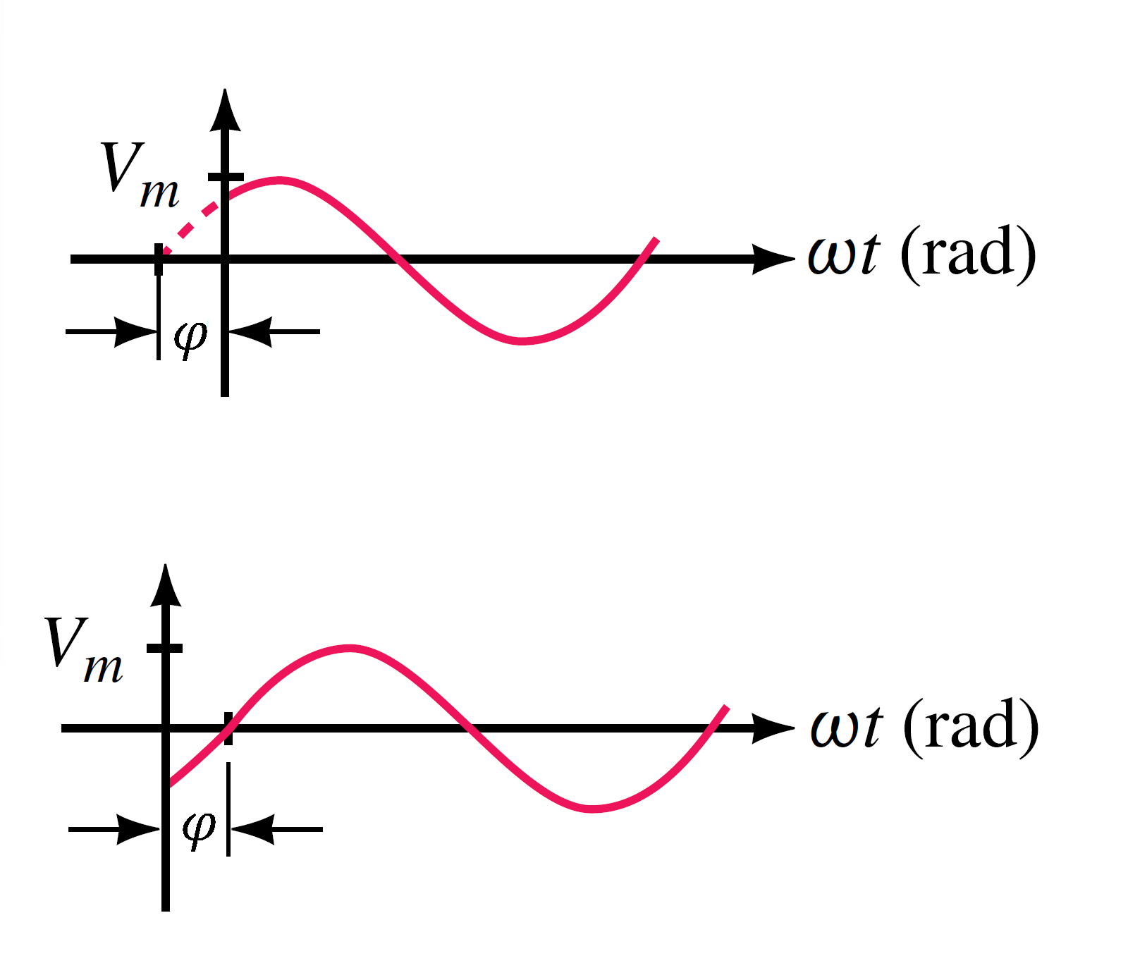


Phase Shift
If a sine wave does not pass through zero at t = 0 s as in Figure below, it has a phase shift. Waveforms may be shifted to the left or to the right.
$${v=V}_{m}sin⁡(ωt+φ)$$
$${v=V}_{m}sin⁡(ωt−φ)$$

Slide 13
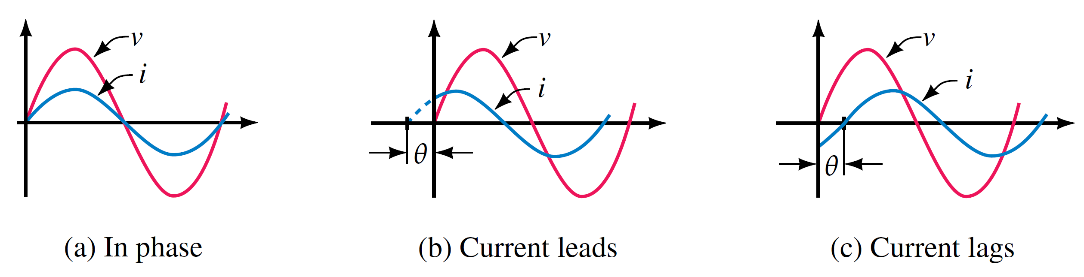
Phase Difference
Phase difference refers to the angular displacement between different waveforms of the same frequency.

Slide 14
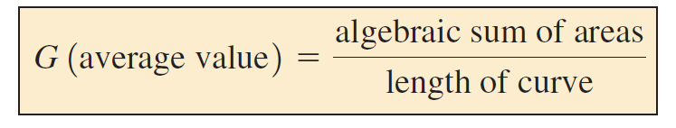
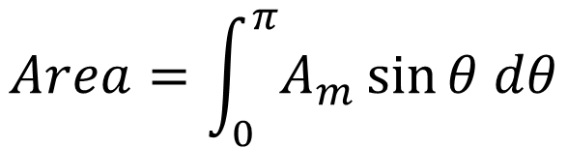
AVERAGE VALUE
$$Area=\int_{0}^{π}{A_{m}\sin{θ dθ}}$$

Slide 15
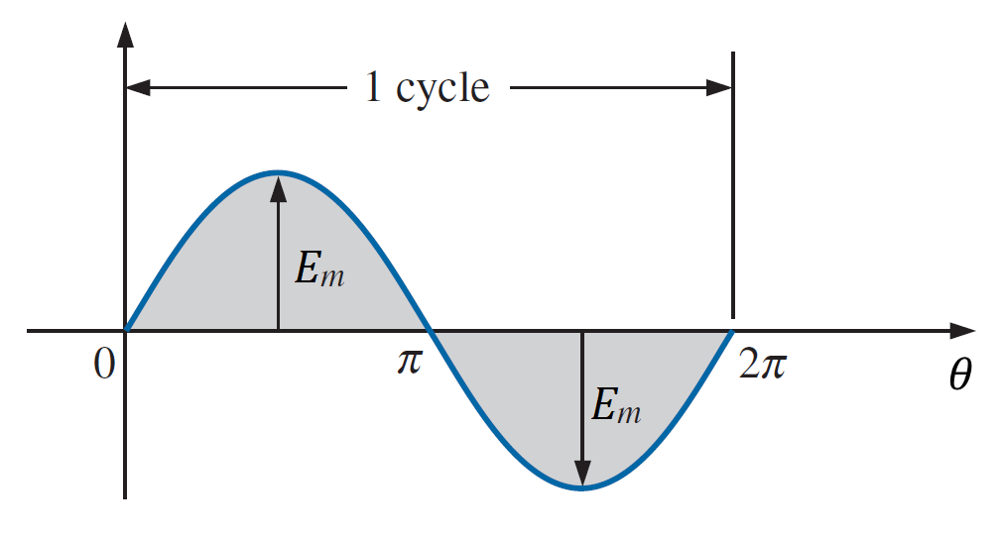
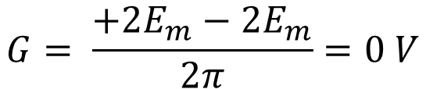
AVERAGE VALUE
EXAMPLE 2: Determine the average value of the sinusoidal waveform in Figure shown.
Solution: By inspection it is fairly obvious that
the average value of a pure sinusoidal waveform over one full cycle is zero.
$$G= \frac{{+2E}_{m}−{2E}_{m}}{2π}=0 V$$

Slide 16
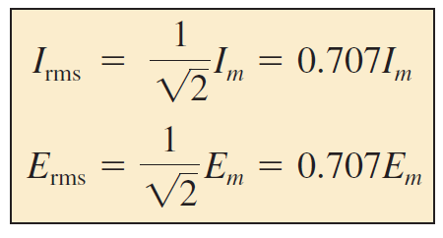
EFFECTIVE VALUES (RMS)
The equivalent dc value of a sinusoidal current or voltage is $\frac{1}{\sqrt{2}}$ or 0.707 of its peak value.

Slide 17
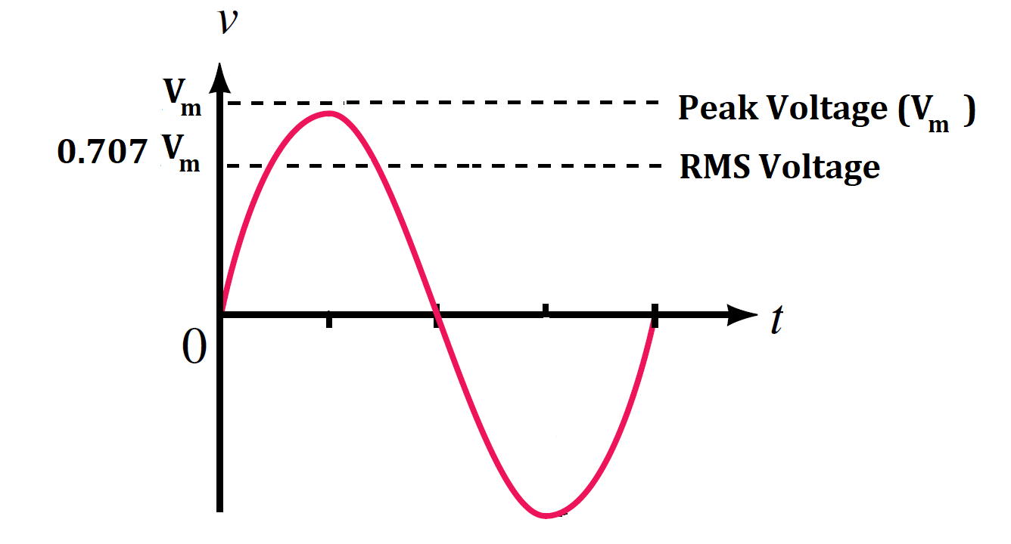
EFFECTIVE VALUES (RMS)
The equivalent dc value of a sinusoidal current or voltage is $\frac{1}{\sqrt{2}}$ or 0.707 of its peak value.

Slide 18
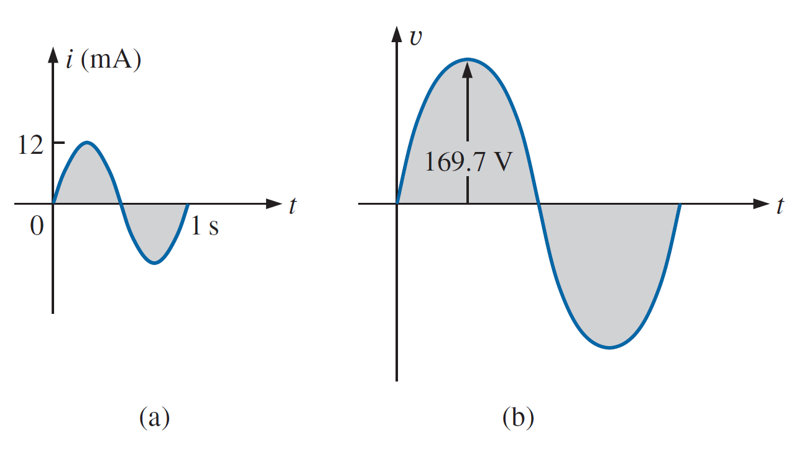






EFFECTIVE VALUES (RMS)
EXAMPLE 3: Find the rms values of the sinusoidal waveform in each part in Figure shown.
Solution:
For part (a),
$$I_{rms}=0.707 I_{m}$$
$=0.707 (12×{10}^{−3})$
$=8.48 mA$
For part (b),
$$V_{rms}=0.707 V_{m}$$
$=0.707 (169.7)$
$≅120 V$

Slide 19



EFFECTIVE VALUES (RMS)
EXAMPLE 4: Determine the effective values (rms) of
$$\left(a\right) i=10\sin\left(ωt\right)A$$
$$\left(b\right) i=50\sin\left(ωt+{20}^{o}\right)mA$$
$$\left(c\right) v=100\cos\left(2ωt\right)V$$
Solution:
Since effective values depend only on magnitude,
${\left(a\right) I}_{rms}=0.707 I_{m}$ $=0.707 \left(10 A\right)=7.07 A$
${\left(b\right) I}_{rms}=0.707 I_{m}$ $=0.707 \left(50 mA\right)=35.35 mA$
${\left(c\right) V}_{rms}=0.707 V_{m}$ $=0.707 \left(100 V\right)=70.7 V$

Slide 20
References
Boylestad, Robert L. Introductory circuit analysis. Pearson Education, 2010.
Robbins, Allan H., and Wilhelm C. Miller. Circuit analysis: Theory and practice. Cengage Learning, 2012.
Sadiku, Matthew NO, and Chales K. Alexander. Fundamentals of electric circuits. McGraw-Hill Higher Education, 2007.

